Slide 1



Analysis On Churn
(Telecommunication Domain)

Slide 2


NAME : SRAVYA DEGALA QUALIFICATION : M. Sc (Statistics)
NAME : SIVA SAI TUNIKIPATI
QUALIFICATION : B.TECH (Mechanical)
NAME : RAHUL BANDI
QUALIFICATION : B. Sc (Mathematics Electronics Computer Science)

Slide 3

DOMAIN KNOWLEDGE :
The word telecommunications originated from the
Greek word ‘Tele’ means ‘distant’
Latin word ‘communicate’ which means ‘to share.’
Telecommunication is well known as telecom, which is the exchange of information / data from place to another place by means of electronic devices such as mobiles, radios, wired phones etc.
The information / data could be of any type such as text, image, voice, video etc..
Telecommunication plays a vital role in connecting people, businesses, and organizations, enabling communication global connectivity and collaboration.

Slide 4

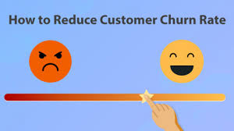


OBJECTIVE :
Understand and reduce customer churn in the telecom industries.
Improving customer retention and overall business performance.

Slide 5
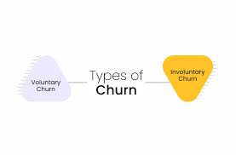
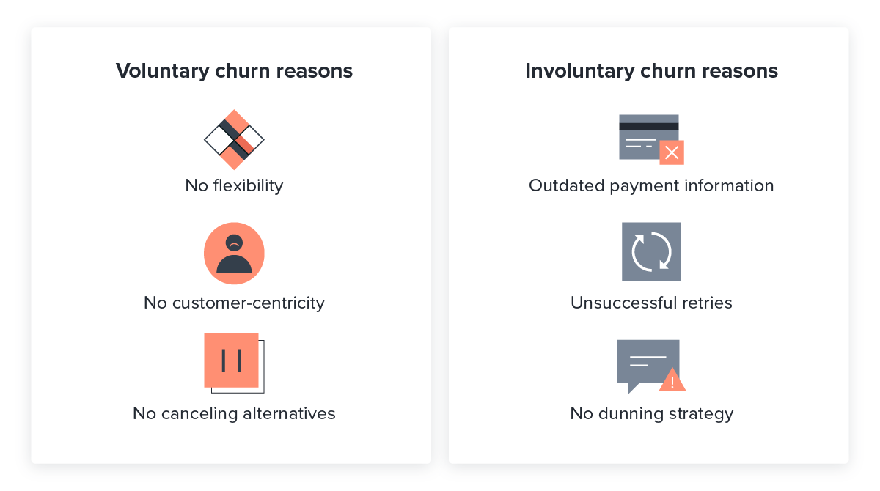
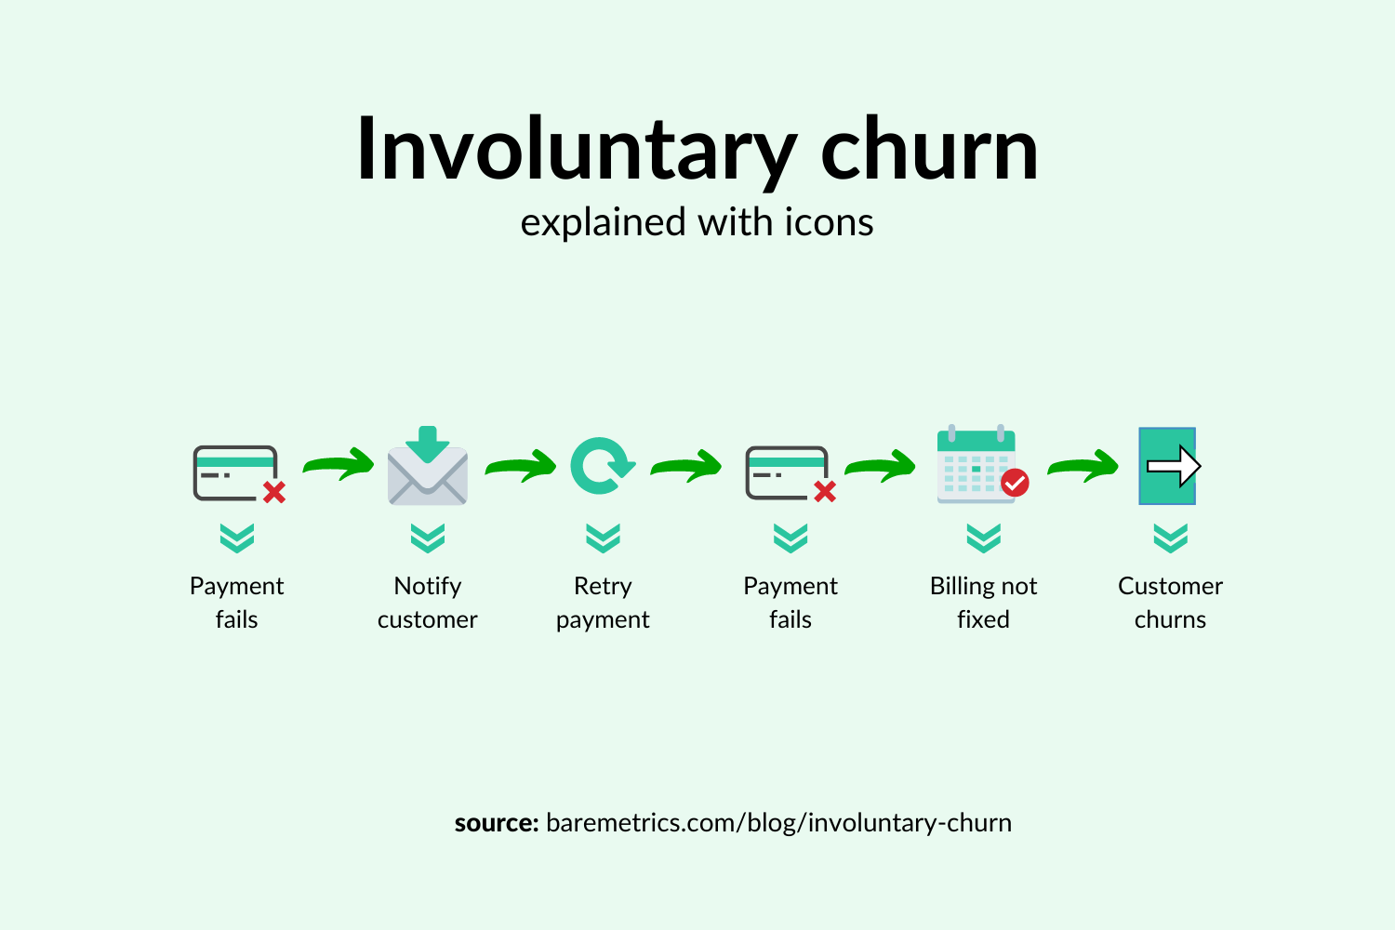
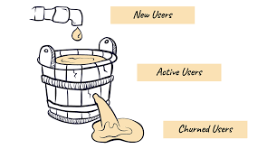
CHURN OVERVIEW:
Churn is a percentage measurement of people who either cancel or choose not to renew their subscriptions.
A high churn rate can negatively impact Revenue of the firm and can also indicate dissatisfaction with a product or service.
Reason behind churn is either because
Switching to a competitor or alternative solution.
No longer interested in products or service usage.
Unhappy with their user experience.
No longer afford the cost.

Slide 6
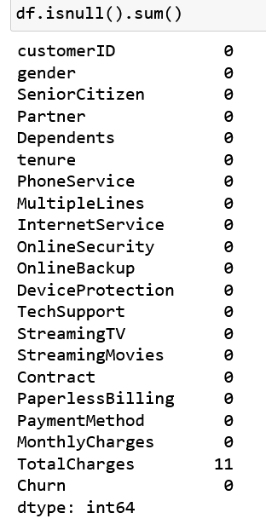
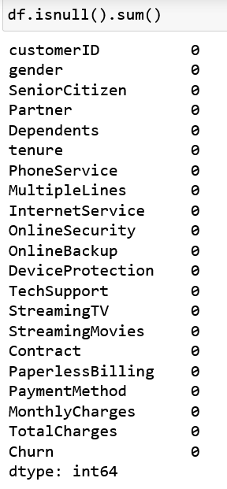

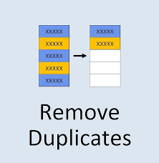

DATA CLEANING STEPS:
The goal is to ensure that the data is accurate, consistent, and suitable for subsequent analysis
Before Cleaning
After Cleaning

Slide 7

DATA ANALYSIS:
Univariate
There are several types of data analysis, some of which are:
Descriptive analysis
Exploratory analysis
Inferential analysis
Advanced analysis
Prescriptive analysis
Predictive analysis
Diagnostic analysis
Bivariate
Multivariate
Exploratory Analysis

Slide 8
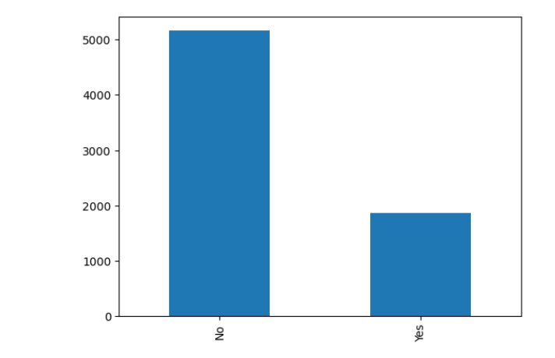
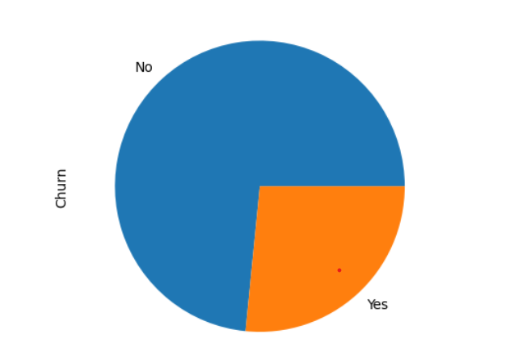
Analysis on Churn :
Bar graph shows the count of costumer's who are likely to churn.
Pie plot shows the percentage of costumer’s who are likely to churn.

Slide 9
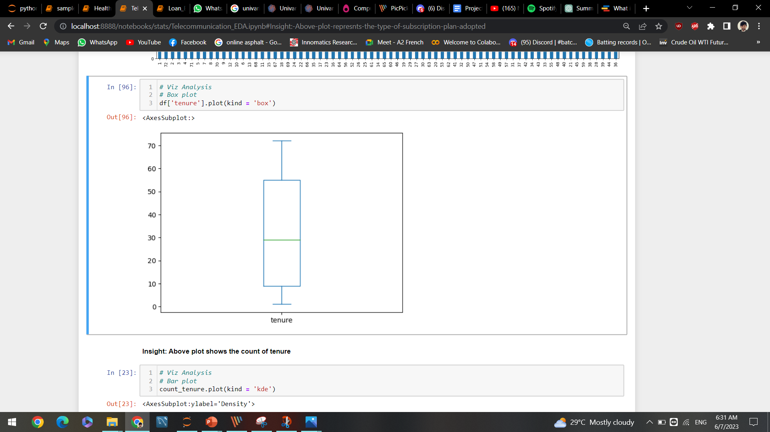
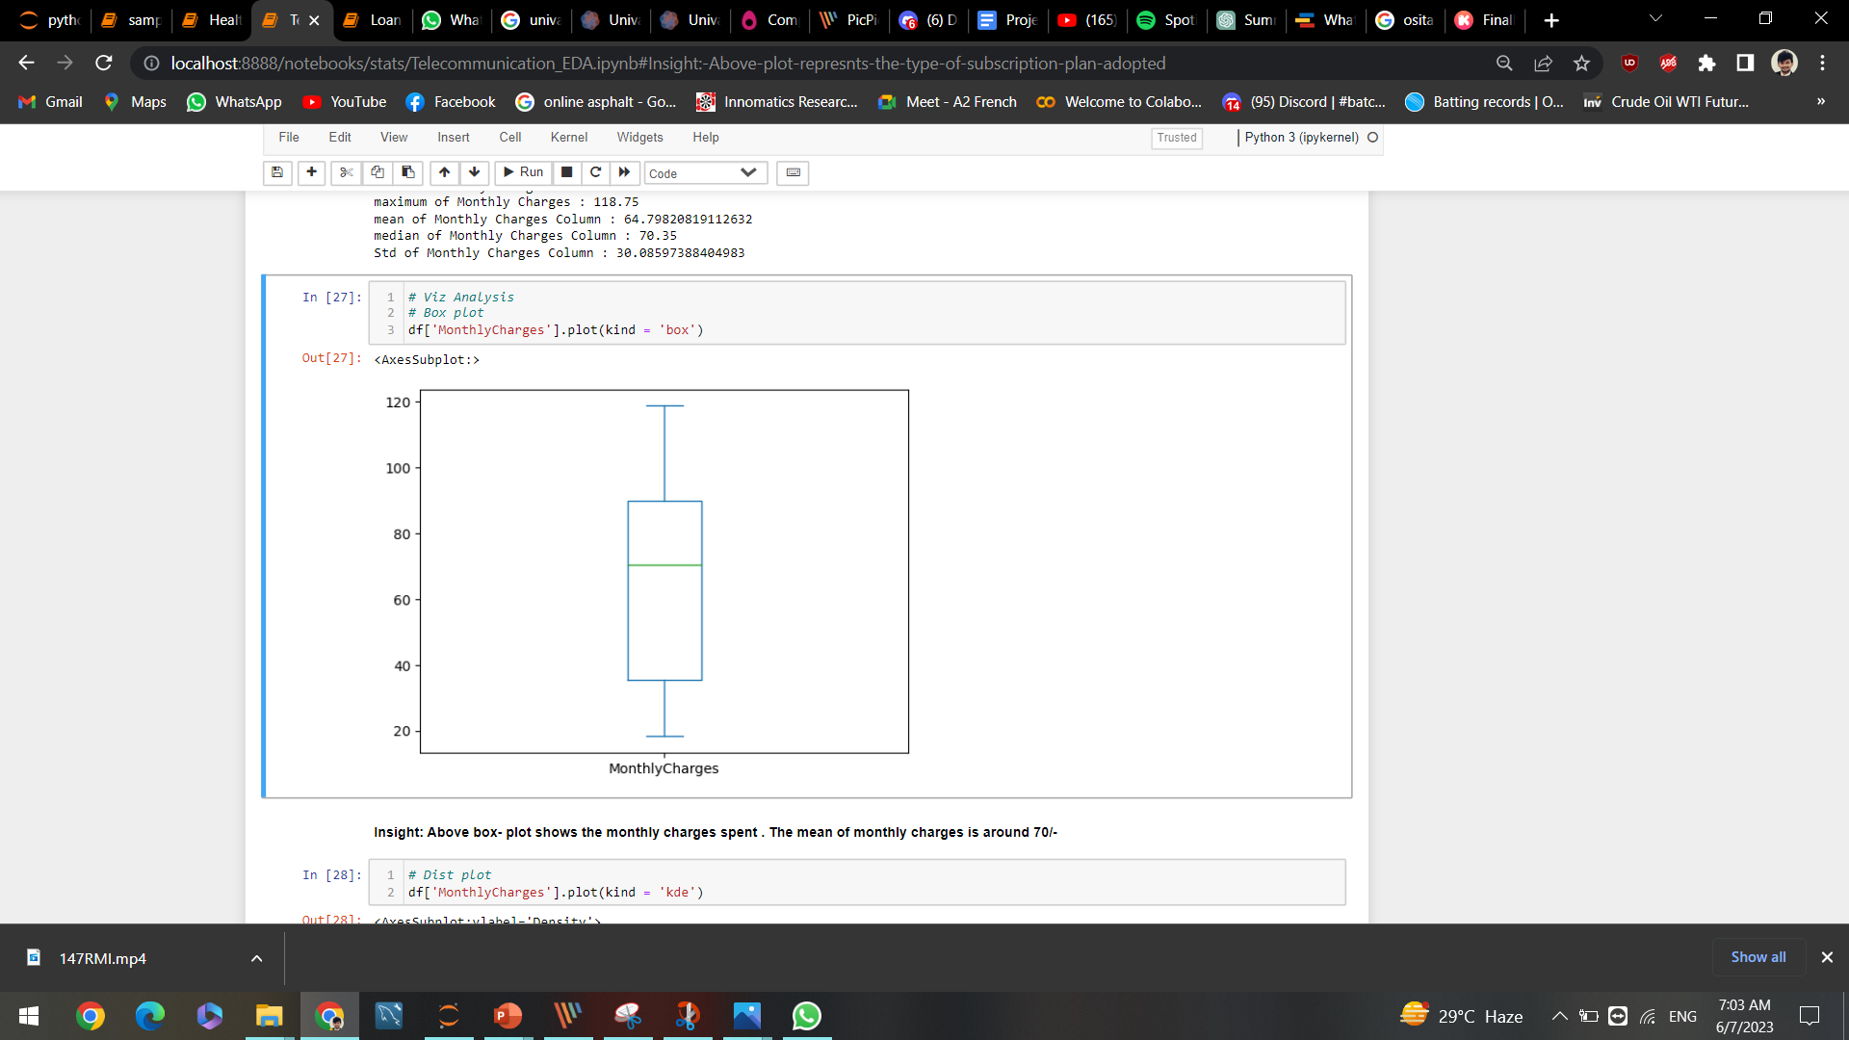
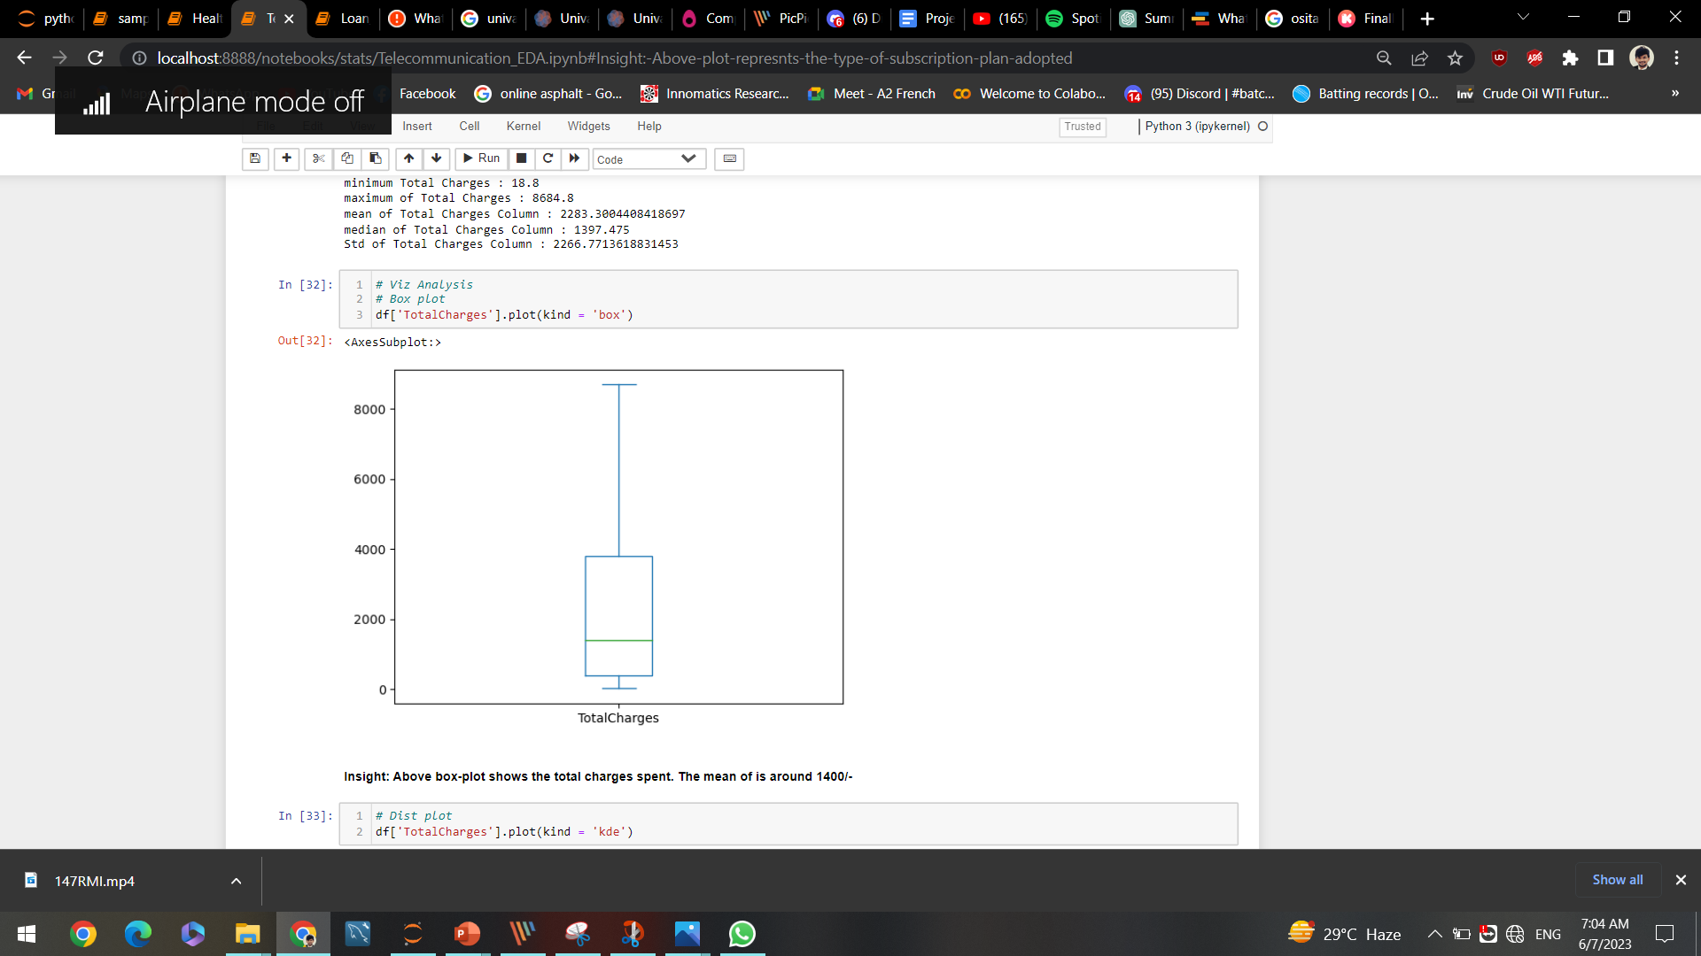
Analysis on some imp Numerical columns :
Box plot on tenure
Box plot on monthly charges
Box plot on total charges

Slide 10
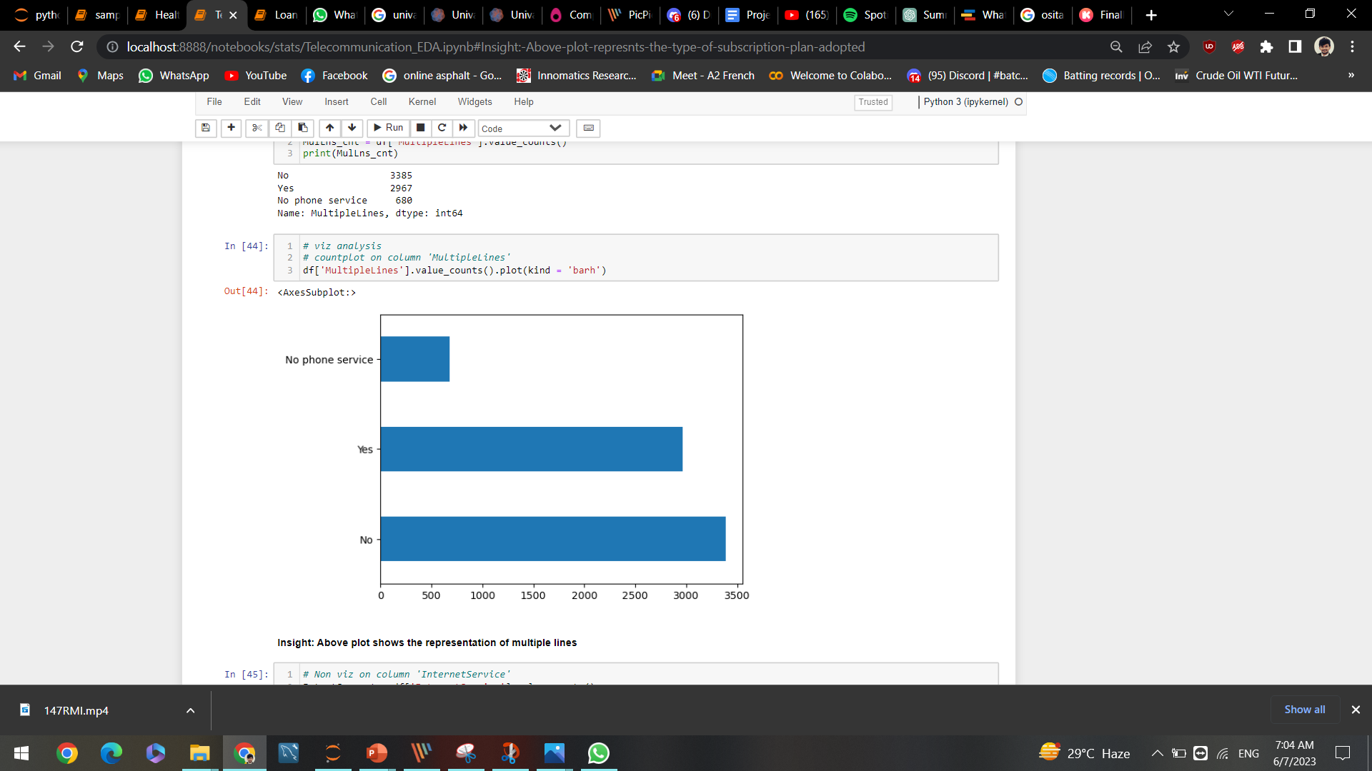
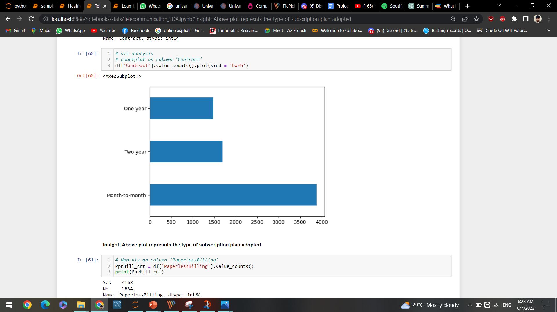
Analysis on some imp Categorical columns :
Count plot on multiple lines
Count plot on contract

Slide 11
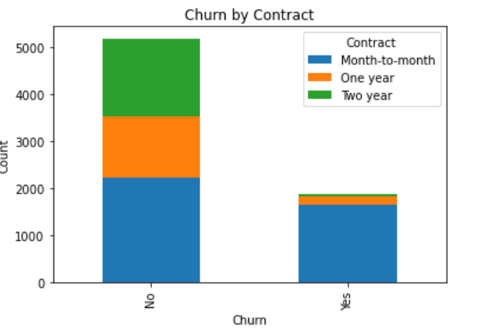
Relationship between Churn and Contract:
Customers on short time contract are more interested with services. and some are not even having any services.
Customers on long-term contracts are less in number. So, Some precautions should be taken to increase long time contract.

Slide 12
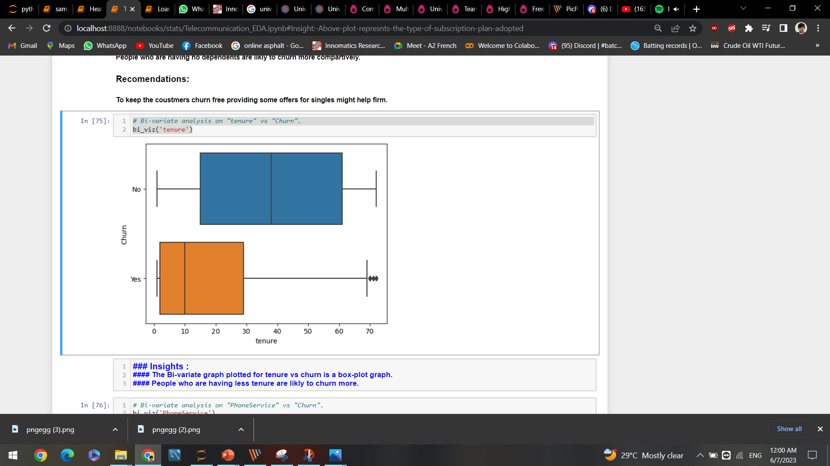
Relationship Between Churn and Tenure:
Customers who have been with the company for a shorter duration may be more likely to churn compared to long-term customers.

Slide 13
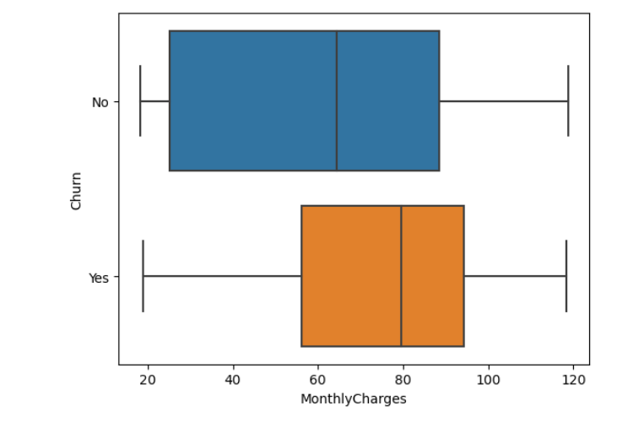
Relationship Between Churn and Monthly Charges :
Higher monthly charges could potentially contribute to customer churn, especially if customers perceive that they are not receiving sufficient value for the cost.

Slide 14
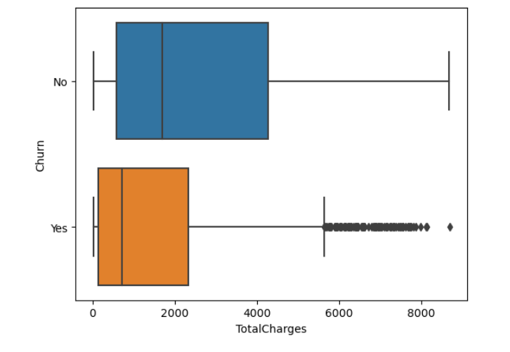
Relationship Between Churn and Total Charges :
Customers with higher cumulative charges over their tenure may be less likely to churn, as this indicates a stronger investment in the company's services.

Slide 15
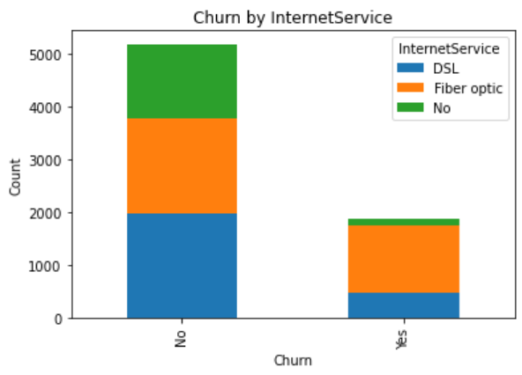
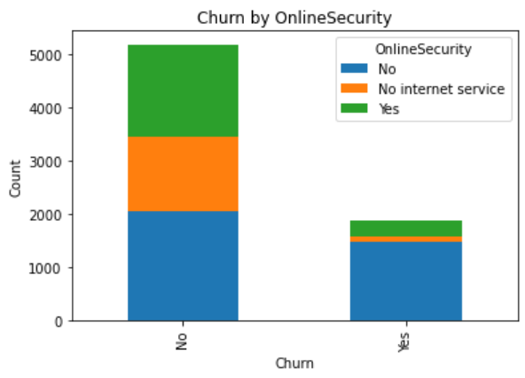
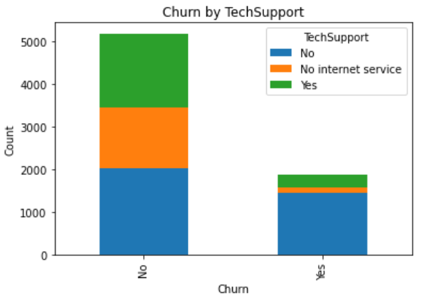
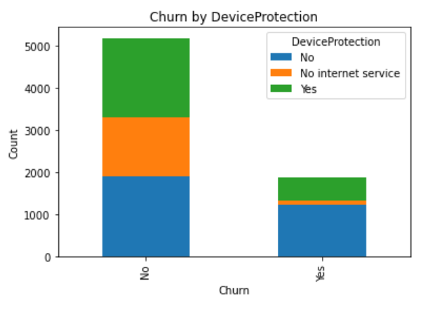
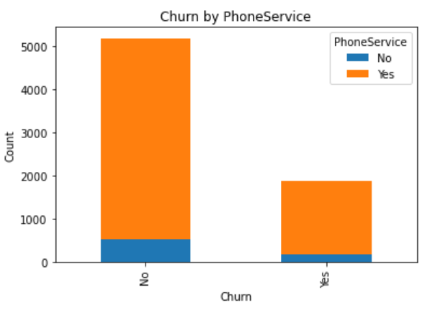
Relationship Between Churn and Services Subscribed:
The specific services customers have signed up for may impact churn. For example, customers who have subscribed to multiple services may be less likely to churn compared to those with fewer services, as they have a higher level of engagement and dependency on the company.

Slide 16

KEY BUSINESS QUESTIONS :
What are the main factors contributing to customer churn ?
Service quality issues, such as network issues, call dropouts or slow data speeds.
Affordability of plans and packages offered by competitors.
Availability and effectiveness of customer support and assistance.
Lack of promotions.
What are the most effective strategies to attract and retain customers ?
Proper Marketing and Promotions.
Customer Segmentation.
Pricing and Value Proposition.
Network Coverage and Quality.
Introducing Combo Packages.

Slide 17

CONCLUSION :
Our EDA project focused on understanding and addressing the issue of churn in the telecommunication sector. Through comprehensive data analysis and exploration, we identified several significant factors and trends related to customer churn.
We discovered that factors such as contract, tenure, monthly charges, total charges are playing crucial roles in influencing customer churn.
It is essential for telecommunication companies to regularly evaluate and refine their strategies to regulate churn rate.

Slide 18

RECOMMENDATIONS :
Few recommendations to reduce churn or to retain lost costumers.
Improve Customer Experience.
Offer Packages and Pricing.
Proactive Churn Prediction and Prevention.
Enhance Network Quality and Reliability.
Build Strong Customer Relationships.

Slide 19

CHALLENGES FACED :
To gather Domain knowledge.
While converting data type of column ‘TotalCharges’ from Object type to Float type.
As there are many columns EDA took time to find out the columns which really impacts churn.

Slide 20

Thanks for your
kind attention
Queries , If any please

